Slide 1

WIPRO NGA Program – DWS
Capstone Project Presentation – 4th Sep & 5th Sep 2025
Project Title - Building An MSIX Package with Framework Package Dependencies
Presented by - Kamran Akmal, Tejas Zinjade, Shrawani Balwadkar,
Gaddapara Chenchu Umasree
www.rpsconsulting.in

Slide 2


INTRODUCTION
MSIX is Microsoft’s modern app packaging format that combines the best features of MSI and AppX.
It improves deployment, updates, and security compared to traditional installers.
Applications often require runtime frameworks like VCLibs or .NET to function properly.
By adding these as dependencies, we ensure applications run reliably across all systems.
Our project demonstrates packaging an application into MSIX with integrated dependencies.
2025 - RPS Consulting all rights reserved

Slide 3
OBJECTIVE
The primary objective was to create a self-contained MSIX package including framework dependencies.
This eliminates common issues caused by missing runtimes on user machines.
It simplifies deployment for IT administrators by reducing manual steps.
The approach enhances the end-user experience with smooth, ready-to-use installations.
It also enables centralized management and easier updates across enterprise environments.
2025 - RPS Consulting all rights reserved

Slide 4




TOOLS & RESOURCES
MSIX Packaging Tool – Used to capture and convert the installer into a base MSIX package.
Advanced Installer – Integrated framework dependencies into the package manifest.
Self-Signed Certificate – Ensured the package was digitally signed and trusted.
Framework Packages – Included required runtimes such as VCLibs and .NET.
PowerShell Scripts – Assisted in certificate installation and package deployment.
2025 - RPS Consulting all rights reserved

Slide 5
MINIMUM REQUIREMENTS
System Requirements-OS:
Windows 10/11, or Windows Server 2016+
Disk: At least 10 GB free for repackaging/testing
Rights: Local admin privileges for packaging workstation
Software Tools
MSIX Packaging Tool (Primary Packaging Tool)
Advanced Installer
Powershell (For Scripting)
Clean Virtual Machine (For Testing Purpose)
2025 - RPS Consulting all rights reserved

Slide 6
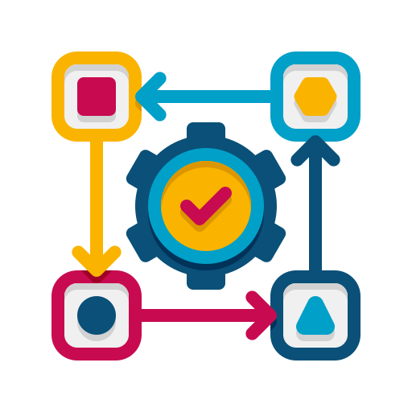
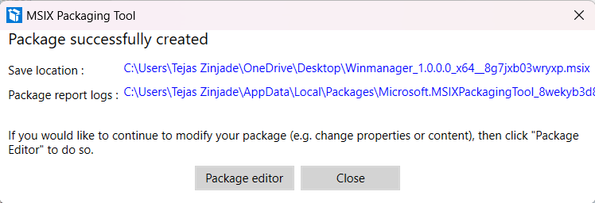
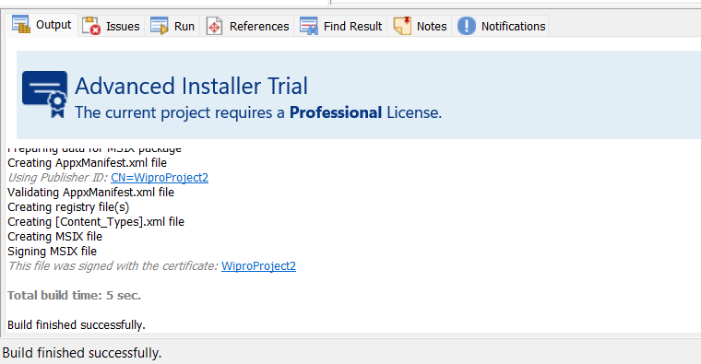
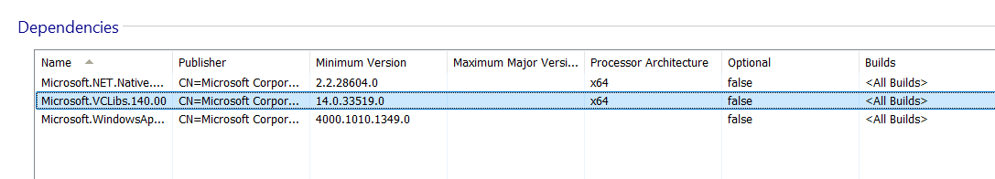
EXECUTION OVERVIEW
Our process followed a two-stage approach for efficiency and reliability.
Created the base MSIX package using MSIX Packaging Tool.
Digitally signed the package with a self-signed certificate.
Imported the package into Advanced Installer to add dependencies.
Built the final MSIX package, fully self-contained and deployment-ready.
1. Package Created
1. Final Package with Dependencies
2. Dependencies Added
2025 - RPS Consulting all rights reserved

Slide 7
REFERENCES
MSIX Packaging Tool – Microsoft Docs
MSIX Fundamentals – Microsoft Learn
Advanced Installer Documentation
VCLibs Framework Package – Microsoft Store Info
.NET Desktop Runtime – Microsoft
PowerShell App Deployment Scripts
2025 - RPS Consulting all rights reserved

Slide 8
Thank You
Thank you for your attention and time.
This project helped us gain hands-on experience in application packaging and dependency management.
We successfully delivered a robust MSIX package that is reliable and deployment-ready.
We look forward to applying this knowledge in real-world enterprise environments.
Your questions, feedback, and suggestions are most welcome.
2025 - RPS Consulting all rights reserved

